Slide 1

Presented by
Musaev Ravshanbek Sadovska Kateryna Zhanabergenov Nazar Shafarenko Mark Saliev Karim
VIRTUAL
MACHINE AND DOCKER
I T - P L A T F O R M E X A M S

Slide 2
ASSIGNMENT
Our team needs to connect 2 virtual machines to the network.
Connect Docker and confirm that everything works between them

Slide 3
OVERVIEW
04 Firewall
13
16
18
21
Docker
Java Docker
System Config. Flask
22
Result
06
07
08
Linux OS
Oracle WM Ubuntu & Debian

Slide 4
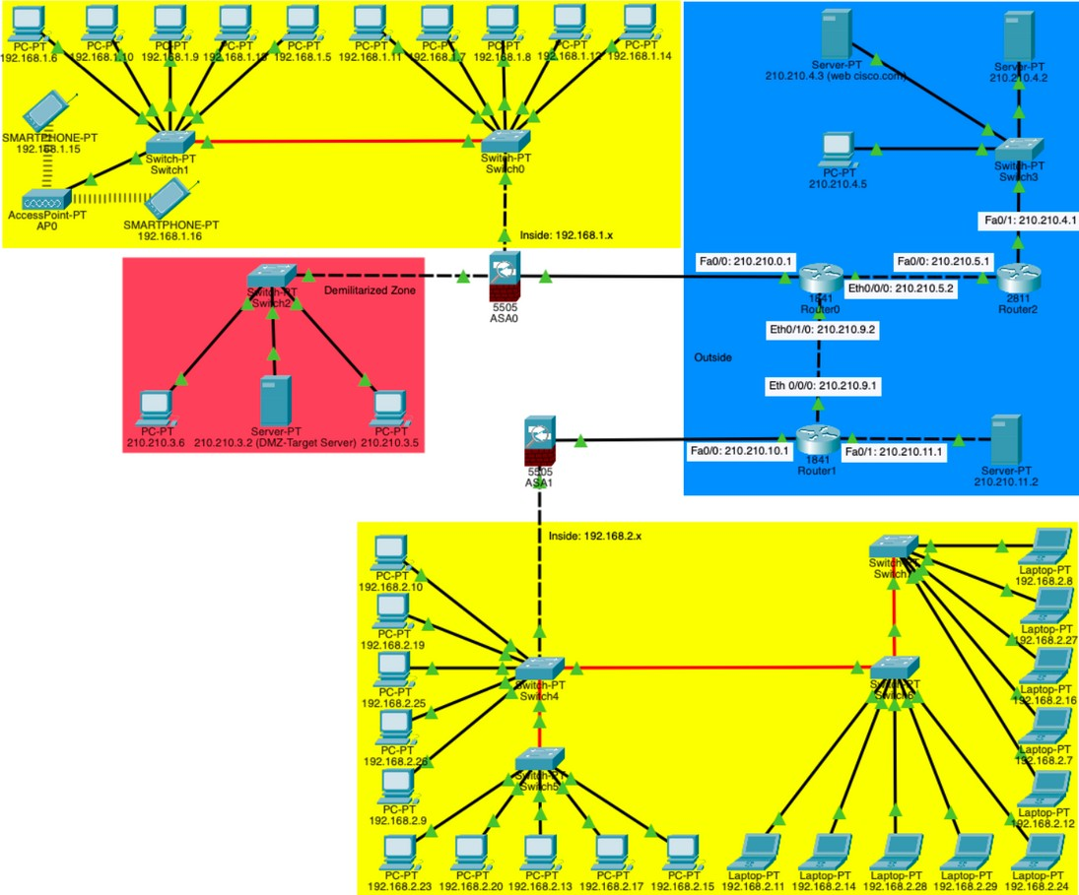
FIREWALL
Using the previous Network system, we added a few changes to it that were necessary for our project.

Slide 5
FIREWALL
What we do:
-change the network into DMZ and add Firewall (in the servers Pool)
- All locations of firewalls based on our design
-Delete the DCHP server and configure the Firewall as it
-Set up Firewall to protect the intrusion from network(outside)

Slide 6
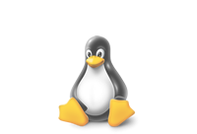
LINUX OS
-||-
is an open-source Unix-like operating system kernel that serves as the foundation for various Linux distributions, providing a powerful and customizable environment for software development. It offers robust support for programming languages, development tools, and a vast array of software libraries, making it a preferred platform for coding and building diverse applications.

Slide 7
ORACLE WM
VirtualBox is a powerful virtualization product for enterprise as well as home use.
First of all, we need to download it and customize it to work with virtual machines.

Slide 8

OPERATION SYSTEMS
One of the key tasks was to link the 2 operating systems to each other. Below is a short description of each
Ubuntu
Ubuntu is a widely-used open-source Linux distribution known for its user-friendly interface. Offering different desktop environments it uses the Debian package management system for easy software installation.
Popular in both desktop and server environments, Ubuntu is recognized for its versatility, cloud compatibility, and security features.
Debian
Debian is a highly respected and influential open- source Linux distribution known for its stability, reliability, and commitment to free software principles. It serves as the foundation for several other popular Linux distributions, including Ubuntu.

Slide 9
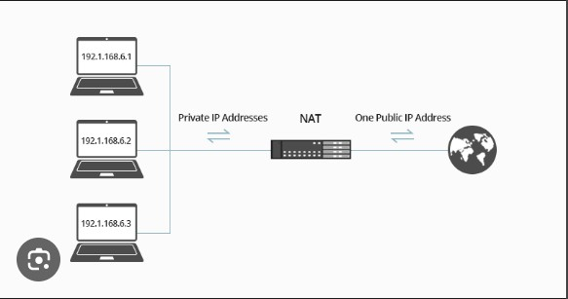
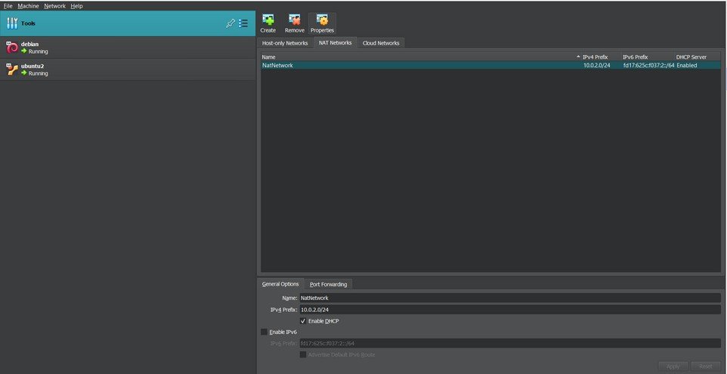
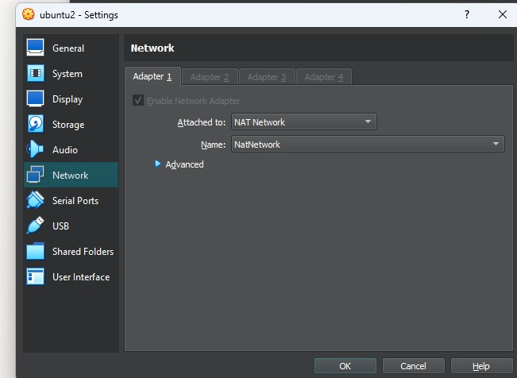
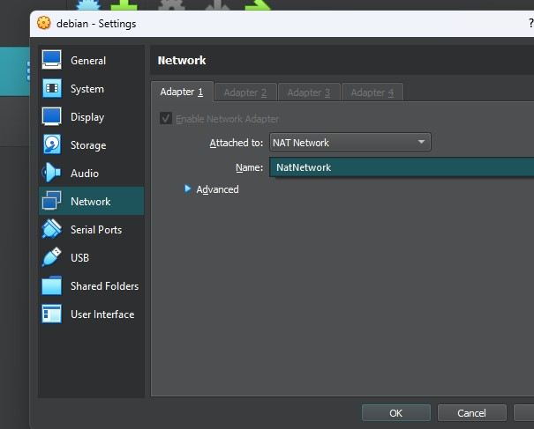

Slide 10

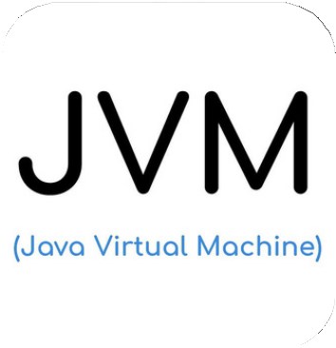
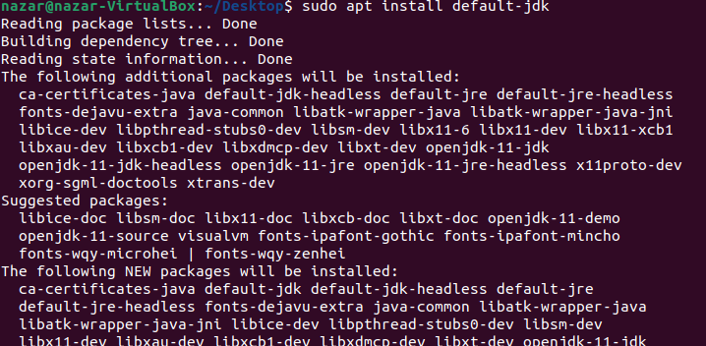
UBUNTU
Create
2 users: normal and admin(user that have access to system parameters)
Full screen mode
Java WM
We need to install and run java here using the command line

Slide 11
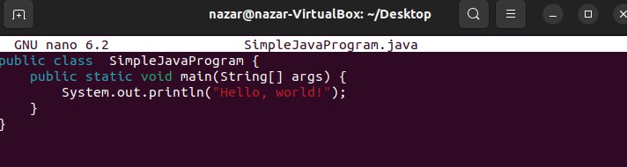
UBUNTU
Java WM
The next step, to see if everything worked, was to write a small program to double- check.

Slide 12
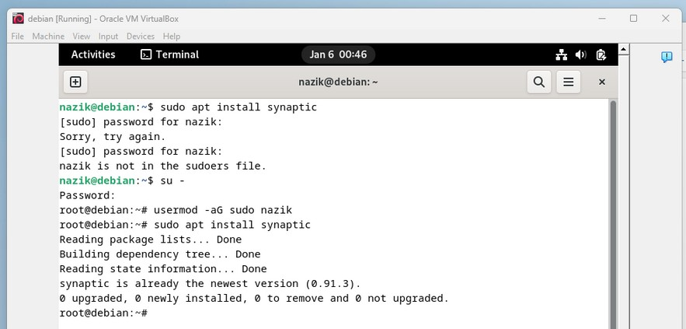
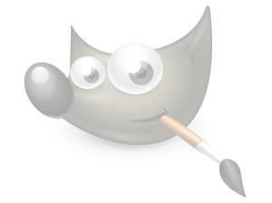
DEBIAN
Create
Install
Sudo user (an account on a Unix-like system with the privilege to execute specific commands with elevated permissions using the "sudo" command, allowing them to perform administrative tasks without logging in)
Synoptic Package Manager using command line
Use
Synoptic PM and install using it any photo redactor. In our case it is gui image manipulation program

Slide 13

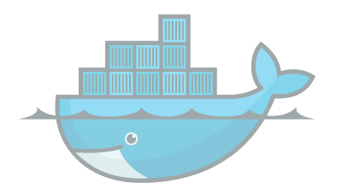
Install
DOCKER
Docker in Ubuntu
Create
a Docker Account in DockerHub ( cloud-based registry service that allows developers to store, share, and manage Docker container images for building and deploying applications in containerized environments.
Pull
Hello World photo and run it.
Also pull the docker image from DHub and launch.
Docker is a widely-used platform for developing, shipping, and running applications in containers. Containers are lightweight, portable, and isolated environments that package an application and its dependencies, allowing it to run consistently across different environments.

Slide 14
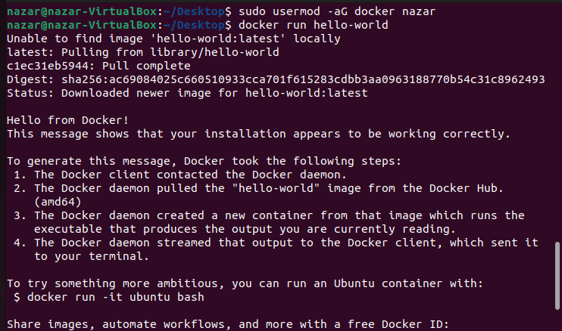
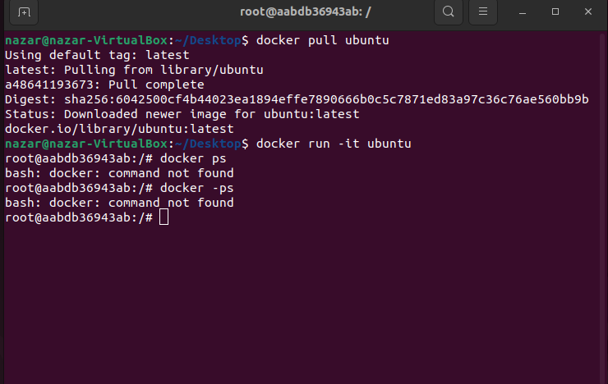

Slide 15
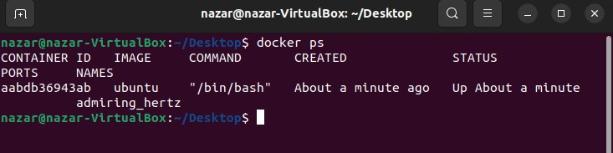
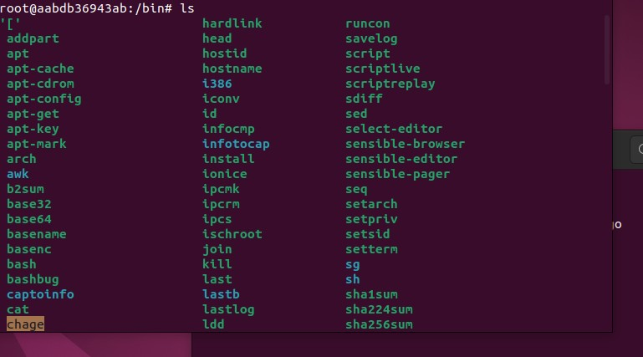
Check
Containers that we run
Run
the batch in the Ubuntu container and check the trash(bin) folder. After create new IS command

Slide 16


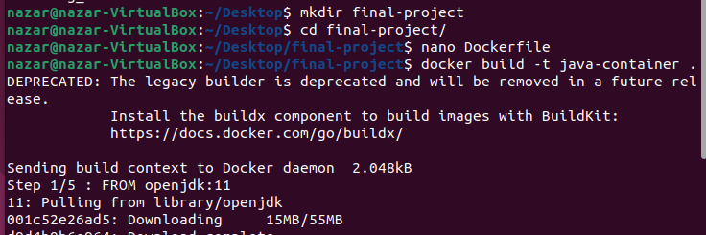
JAVA DOCKER
Using
the Java Program that we create before we need to run this progran inside the Container
In Ubuntu
create a new Directory using only command line
Create
Docker file

Slide 17

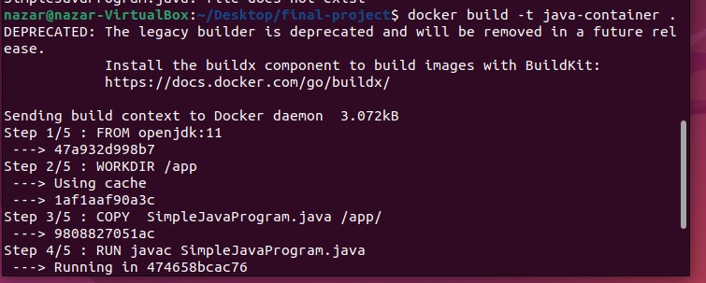
JAVA DOCKER
the Docker file to create Java Container and then run the container to see the results
Run

Slide 18
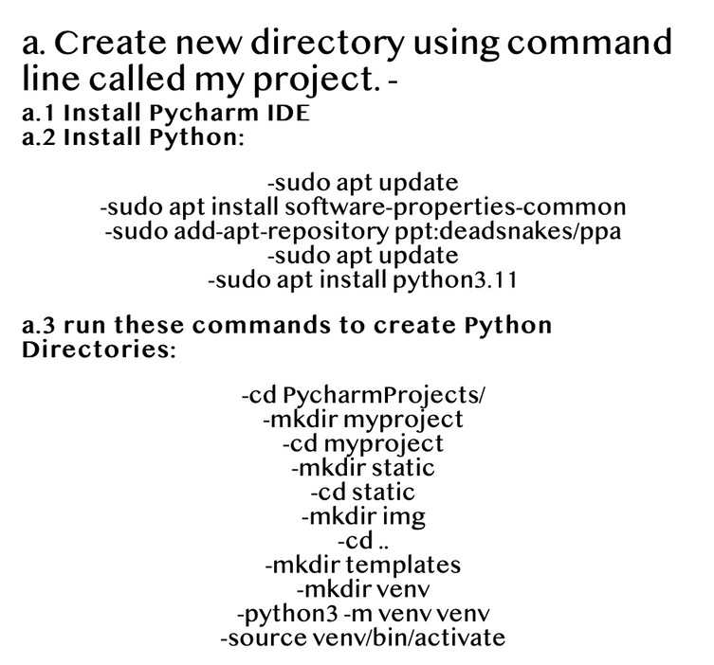
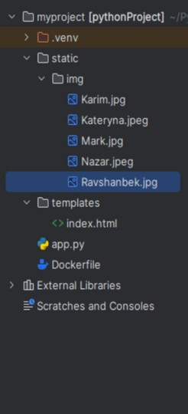
In Ubuntu
System configurations encompass the settings and parameters that define the behavior and operation of a computer system, including hardware, software, and network settings.
SYSTEM CONFIGURATI
ONS
In task we got 2 codes: python and html. them we need
change the system configurations
First of all create a new DIrectory using command line and named it my project

Slide 19

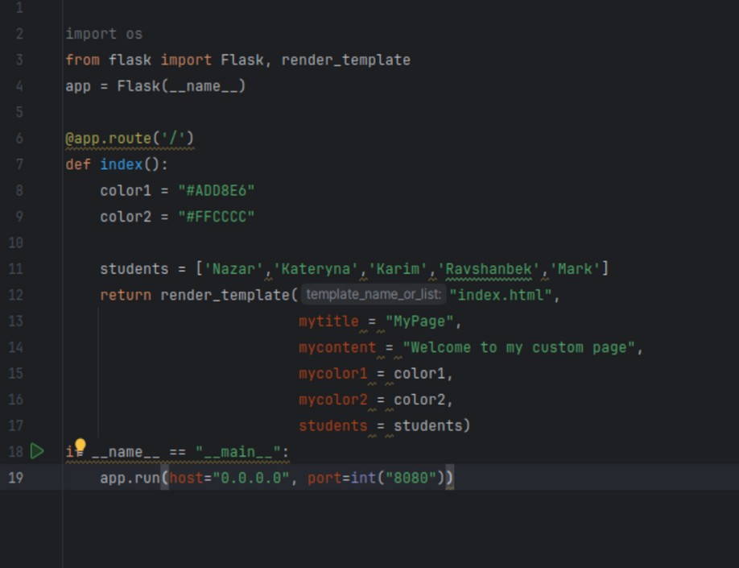
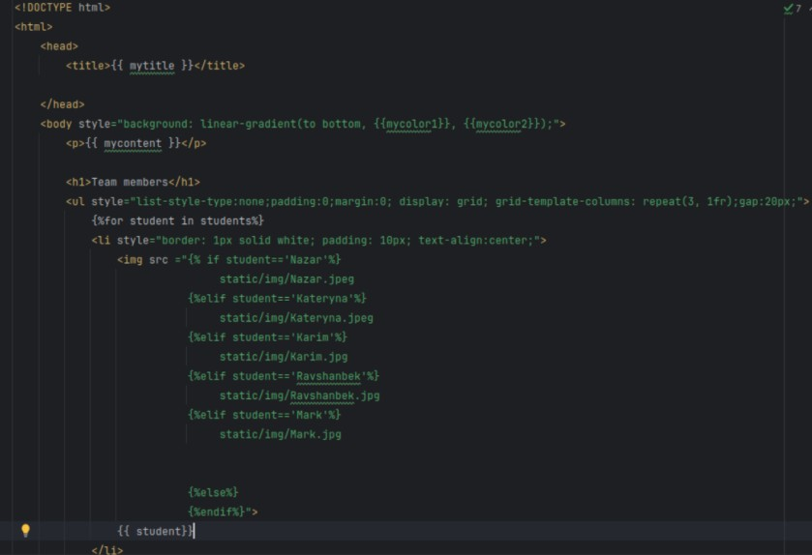
Myproject
folder has a python code and template directory which has the second- html code

Slide 20
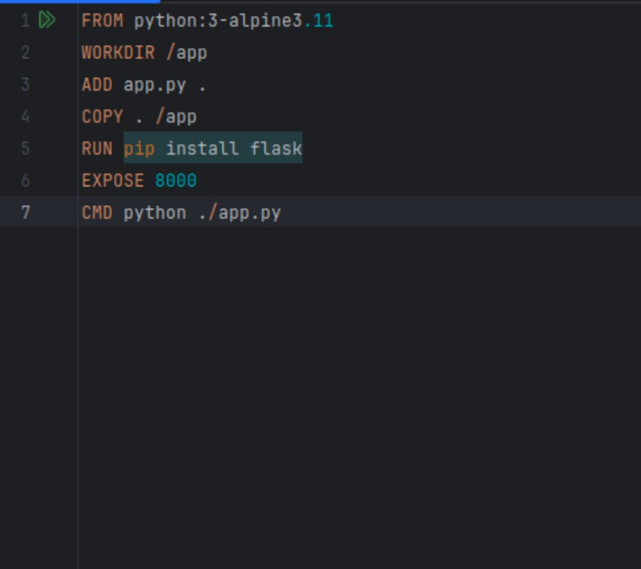
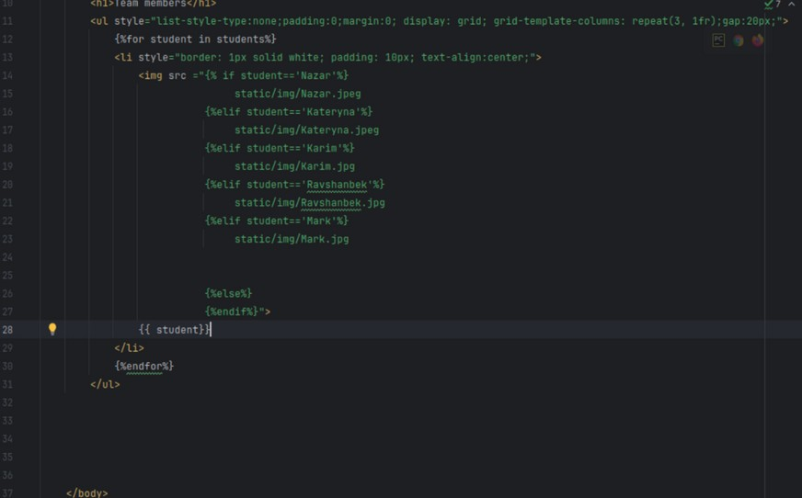
Docker File

Slide 21
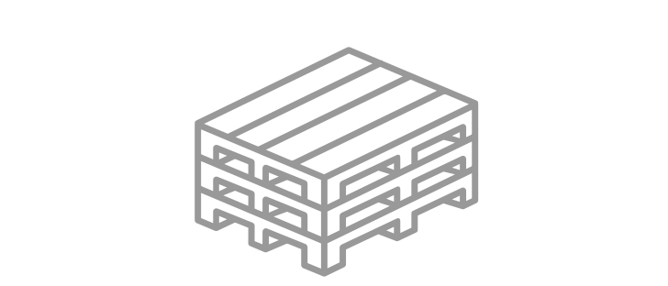
Create
FLASK
Flask is a lightweight Python web framework developed by the Pallets Projects organization. Pallets Projects is a collection of Python libraries, and Flask is designed for simplicity in building web applications. It relies on WSGI through the Werkzeug utility library and incorporates Jinja for templating. Other Pallets Projects components, such as Click, contribute to Flask's functionality.
Known for its minimalistic design, Flask provides essential features for web development, allowing developers to choose additional components as needed for their projects.
proper docker file and install python and flask
Run
docker file and create by this python container for future. After run this container and check the
output using netwirk mapping to launch code.

Slide 22
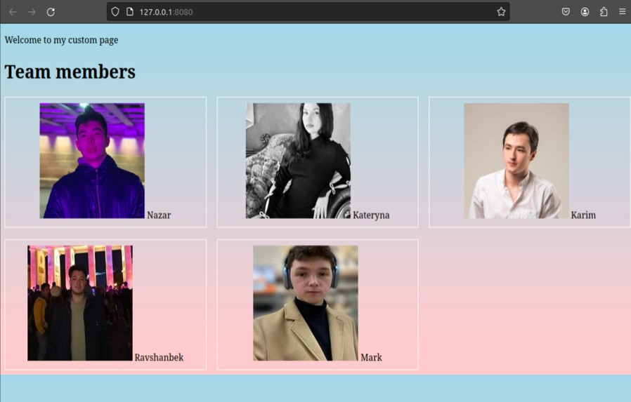
RESULT
If we want to end up with our site, we need to do a couple of additional things.
Docker login to ‘jolygolden’ account docker build -t
docker push
docker pull
docker run -it --rm -p 8080:8080

Slide 23
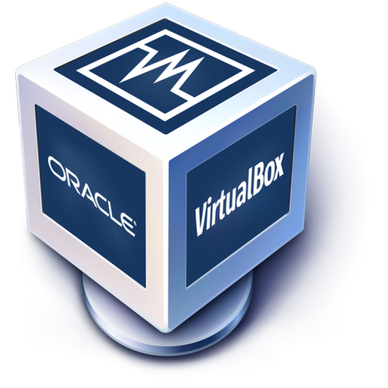
THANK YOU!

